Slide 1



















Geospace Exploration Mission
2011 SuperDARN Workshop
ERG
Energization and Radiation in Geospace
Y. Miyoshi (1), T. Ono (2), T. Takashima (3), K. Seki (1), K. Shiokawa (1),
N. Sato (4), T. Nagatsuma (5), N. Nishitani (1), T. Hori (1), Y. Miyashita (1),
T. Segawa (1), A. S. Yukimatu (4), K. Hosokawa (6), M. Hirahara (1),
K. Asamura (3), T. Obara (3), Y. Kasaba (2), A. Kumamoto (2), A. Matsuoka (3),
H. Kojima (7), M. Fujimoto (3), and V. Angelopoulos (8)
ERG working group, ERG science center task team
(1) STEL, Nagoya University, Japan, (2) Tohoku University, Japan
(3) JAXA, Japan, (4) NIPR, Japan, (5) NICT, Japan, (6) UEC, Japan,
(7) RISH, Kyoto University, (8) UCLA/IGPP, USA

Slide 2
OUTLINE
1. Introduction
- science target of the ERG project
2．ERG project
- ERG satellite
- ERG ground networks
- ERG simulation/integrated studies
- science coordination team/project science center
3. International collaboration
4. Collaboration with SuperDARNs
5. Summary

Slide 3
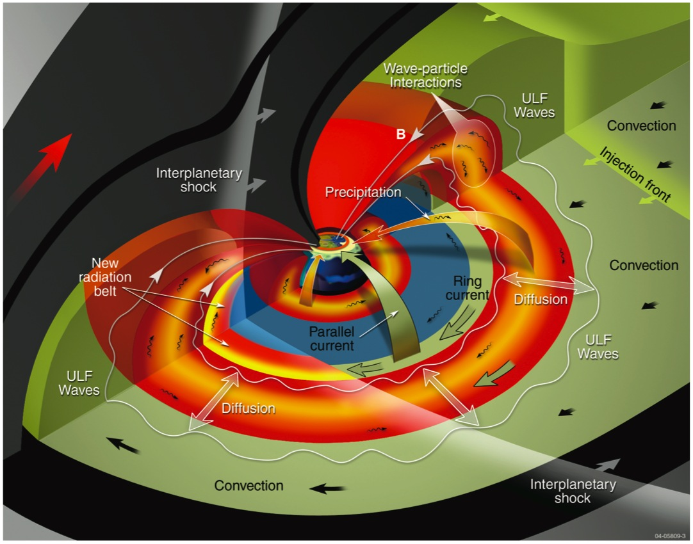
1. Introduction ・・・ dynamical coupling in Geospace
- Particle acceleration/transport
Plasma waves
M-I coupling via FAC
PLASMA SHEET
whistler mode waves (kHz)
Acceleration via
W-P interaction
RING CURRENT (keV)
PLASMASPHERE (eV)
ULF pulsation (mHz)
RADIATION BELTS (MeV)
Acceleration via
radial diffusion
(NASA RBSP website)
Notes:
A cut-away view of the magnetosphere, showing the dusk equatorial plane and the noon-midnight-north pole plane, illustrates in three dimensions the many physical phenomena occurring during magnetically active periods.
The spacecraft will orbit approximately coincident with this equatorial plane. Particle angular distributions to be measured at the equator will also give the distributions along the magnetic field lines. Distortions of the magnetic field from the particle energy density distributions maximize at the equator, and the geoelectric field at the equator maps down magnetic field lines to the ionosphere.
Over the course of the two year mission, the orbit will precess, approximately twice, through these inner magnetospheric regions and collect observations for many magnetic storms.

Slide 4
Particles in the inner magnetosphere
relativistic
(～ MeV)
inner belt
outer belt
sub-relativistic
energy
hot
(～ 100 keV)
ring current
plasma sheet
thermal
(～eV)
plasmasphere
L=3
L=6
distance from the earth
In the inner magnetosphere, widely differing energies over 6 orders
coexist same region.
Notes:
In the inner magnetosphere, as you know, a lot of kind of plasma and particles coexist.
This figure is schematic picture showing the region and energy range of plasma in the inner magnetosphere.
This axis is L value, indicating from inner magnetosphere to plasma sheet.
On the other hand, this axis is energy from a few eV (thermal energy range) to MeV (relativistic energy).
As the most higher energy range, there are radiation belts, and basically there are two different region of electrons; inner and outer belt.
In the energy around few 10 keV, there exits ring current around L=3 to 6.
The plasma sheet also exists in the night side.
Moreover, in the near earth region, there is plasmasphere.
The origin of the plasmasphere is thermal plasma from ionosphere.
Thus, in the inner magnetosphere, the particles with energy range of order 6 and different origin, solar wind/ionosphere, coexist.
And also, ion population is not only proton but also several heavy ions.

Slide 5
External Source : MHD/Pc5 – particle interactions
external source (radial diffusion) --- violation of third invariant
relativistic
(～ MeV)
inner belt
outer belt
MHD waves
Pc5
sub-relativistic
hot
(～ 100 keV)
diffusion
energy
ring current
plasma sheet
thermal
(～eV)
large magnetic
moment
plasmasphere
L=3
L=6
Transportation via MHD/Pc5 pulsations is important for particle acceleration.
Notes:
In the inner magnetosphere, as you know, a lot of kind of plasma and particles coexist.
This figure is schematic picture showing the region and energy range of plasma in the inner magnetosphere.
This axis is L value, indicating from inner magnetosphere to plasma sheet.
On the other hand, this axis is energy from a few eV (thermal energy range) to MeV (relativistic energy).
As the most higher energy range, there are radiation belts, and basically there are two different region of electrons; inner and outer belt.
In the energy around few 10 keV, there exits ring current around L=3 to 6.
The plasma sheet also exists in the night side.
Moreover, in the near earth region, there is plasmasphere.
The origin of the plasmasphere is thermal plasma from ionosphere.
Thus, in the inner magnetosphere, the particles with energy range of order 6 and different origin, solar wind/ionosphere, coexist.
And also, ion population is not only proton but also several heavy ions.

Slide 6
Internal Source via wave particle interactions
internal sources (w-p interactions) – violation of all invariants
relativistic
(～ MeV)
inner belt
outer belt
acceleration
whistler
sub-relativistic
wave growth
energy
hot
(～ 100 keV)
ring current
ring current
plasma sheet
thermal
(～eV)
plasmasphere
L=3
L=6
Whistler mode waves act as a mediating agent via cyclotron resonance
- absorbing a fraction of the power of ring current electrons,
which results in wave growth
- its transfer to the acceleration of high energy electrons.
Notes:
In the inner magnetosphere, as you know, a lot of kind of plasma and particles coexist.
This figure is schematic picture showing the region and energy range of plasma in the inner magnetosphere.
This axis is L value, indicating from inner magnetosphere to plasma sheet.
On the other hand, this axis is energy from a few eV (thermal energy range) to MeV (relativistic energy).
As the most higher energy range, there are radiation belts, and basically there are two different region of electrons; inner and outer belt.
In the energy around few 10 keV, there exits ring current around L=3 to 6.
The plasma sheet also exists in the night side.
Moreover, in the near earth region, there is plasmasphere.
The origin of the plasmasphere is thermal plasma from ionosphere.
Thus, in the inner magnetosphere, the particles with energy range of order 6 and different origin, solar wind/ionosphere, coexist.
And also, ion population is not only proton but also several heavy ions.

Slide 7
Internal Source via wave particle interactions
internal sources (w-p interactions)
relativistic
(～ MeV)
inner belt
outer belt
acceleration
whistler
sub-relativistic
wave growth
energy
hot
(～ 100 keV)
ring current
ring current
plasma sheet
thermal
(～eV)
plasmasphere
L=3
L=6
Cross-Energy Coupling between particles of widely differing energies over 6 orders via wave-particle interactions is important to generate relativistic electrons in the inner magnetosphere.
Notes:
In the inner magnetosphere, as you know, a lot of kind of plasma and particles coexist.
This figure is schematic picture showing the region and energy range of plasma in the inner magnetosphere.
This axis is L value, indicating from inner magnetosphere to plasma sheet.
On the other hand, this axis is energy from a few eV (thermal energy range) to MeV (relativistic energy).
As the most higher energy range, there are radiation belts, and basically there are two different region of electrons; inner and outer belt.
In the energy around few 10 keV, there exits ring current around L=3 to 6.
The plasma sheet also exists in the night side.
Moreover, in the near earth region, there is plasmasphere.
The origin of the plasmasphere is thermal plasma from ionosphere.
Thus, in the inner magnetosphere, the particles with energy range of order 6 and different origin, solar wind/ionosphere, coexist.
And also, ion population is not only proton but also several heavy ions.

Slide 8
2. The ERG project
project goal –
Cross-energy coupling in
generation and loss process of relativistic particles
&
variation of geospace during space storms
Target 1: Dynamics of the radiation belts
particle acceleration, transportation and loss
Target 2: Dynamics of the space storms and ring currents
ring current and electro-magnetic field
variation associated with M-I coupling
Target 3: Dynamics of the plasmasphere

Slide 9
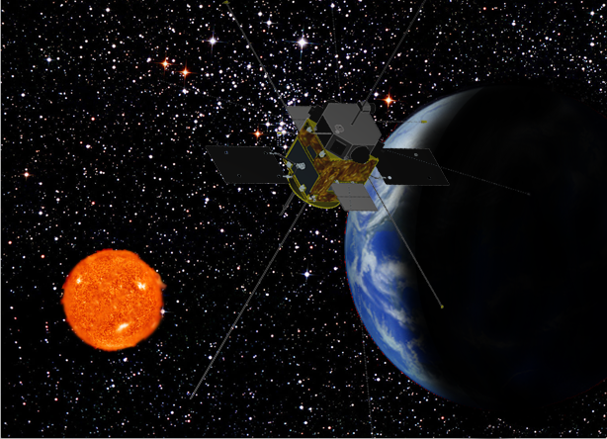
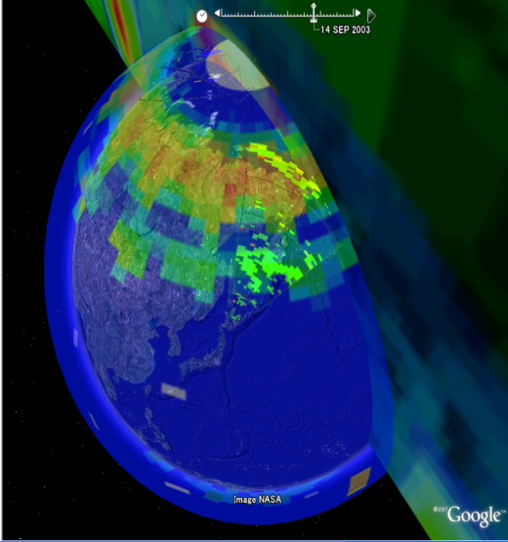
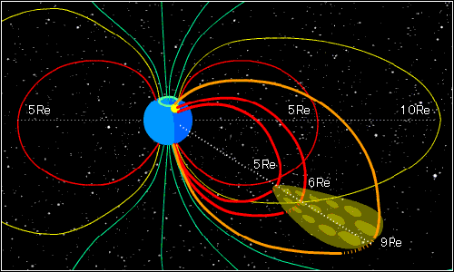
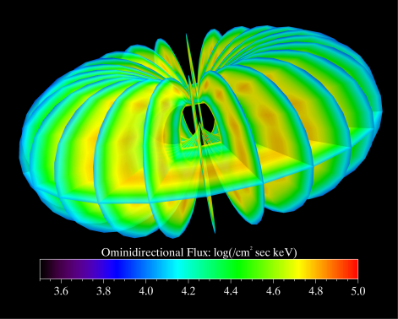
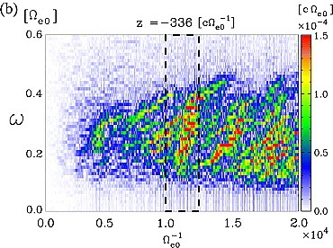
ERG Project Group
ERG-satellite team
ERG-ground network team
REMOTE SENSING
IN-SITU OBSERVATION
ERG-simulation/integrated studiy team
Science Coordination Team
Project Science Center
NUMERICAL SIMULATION/MODELING

Slide 10
ERG Working Group (~100 researchers in 20 universities/institutes)
PI: T. Ono (Tohoku Univ.),
Mission Manager: T. Takashima (ISAS/JAXA), Science Manager: Y. Miyoshi (STEL, Nagoya Univ.)
ERG-satellite
Particle Instrument: M. Hirahara (Nagoya Univ.), T. Yanagimachi (Rikkyo Univ.) T. Takashima, K. Asamura,
Y. Saito, T. Abe, H. Matsumoto, S. Kasahara, M. Shimoyama (JAXA), W. Miyake(Tokai Univ.),
K. Ogasawara (SwRI), Y. Kazama (NCKU)
Plasma Wave& Electric Field Instrument: Y. Kasaba, T. Ono, A. Kumamoto, Y. Kato (Tohoku Univ.),
Y. Kasahara, S. Yagitani, T. Imachi, Y. Goto (Kanazawa Univ.), H. Kojima, Y. Omura, Y. Ueda (Kyoto Univ.),
M. Iizima (Daijyo Syukutoku), H. Hayakawa, T. Muranaka (JAXA), T. Okada, K. Isisaka, S. Miyake
(Toyama Pref. Univ)
Magnetic Field Instrument: A. Matsuoka (JAXA), M. Tanaka, H. Shirasawa (Tokai Univ.), K. Shiokawa
(Nagoya Univ.), Y. Tanaka (NIPR), K. Yumoto, M. Shinohara (Kyushu Univ.), T. Nagatsuma (NICT)
ERG-ground networks
K. Shiokawa, N. Nishitani, T. Kikuchi, Y. Otsuka, R. Fujii (Nagoya Univ.), K. Yumoto, H. Kawano, A. Yoshikawa
(Kyushu Univ.), N. Sato, A. Yukimatsu, H. Yamagishi, A. Kadokura, Y. Ogawa (NIPR), M. Taguchi
(Rikkyo Univ.), K. Hosokawa (U. of Electro-Communications), K. Hashimoto (Kibi International Univ.)
F. Tsuchiya (Tohoku Univ.)
ERG-simulation/integrated studies
K. Seki, Y. Miyoshi, A. Ieda, Y. Ebihara, T. Umeda, S. Masuda, Y. Matsumoto, A. Shinbori, T. Hori,
S. Saito, T. Amano (STEL, Nagoya Univ.), K. Murata, H. Shimazu, H. Shinagawa, N. Terada, H. Jin (NICT),
M. Nakamura (Osaka Pref. Univ.), R. Kataoka (RIKEN), M. Nose, T. Iyemori, Y. Omura, S. Machida
(Kyoto Univ.), T, Obara, M. Fujimoto, I. Shinohara, K. Maezawa, Y. Miyashita, T. Takada (JAXA), T. Tanaka
(Kyushu Univ.), S. Watanabe, K. Komatsu (Hokkaido Univ.), T. Higuchi, G. Ueno, S. Nakano (ISM),
M. Hoshino (U. of Tokyo), T. Nagai, K. Asai, T. Terasawa (TITEC), S. Arvelius (IRF), M. Yamada(MPI)
Notes:
10

Slide 11
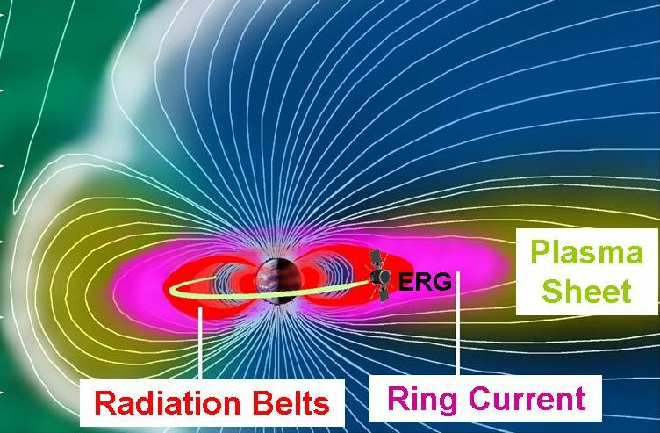
The SPRINT-B/ERG satellite
・apogee geocentric distance： 5.0 Re (L~12) ・perigee altitude: 300 km
・ inclination angle: 31 deg
・planned launch date: FY2014 -2015(plan)

Slide 12
ERG : plasma & particles
PPE: Plasma and Particle Experiment (PI: M. Hirahara, Nagoya Univ.)
MEP FOV
XEP FOV
10 MeV
XEP
1 MeV
HEP-e
inner belt
outer belt
sub-relativistc
100 keV
MEP-i
MEP-e
ring current
ring current
1 keV
LEP-i
LEP-e
plasma sheet
1 eV
plasmasphere
ion
electron
- ERG/ PPE measure widely differing energies over 6 orders
with ion mass discriminations (H+, O+, He+, He++).
- The energy coverage of particle instruments overlaps each other.
Notes:
In the inner magnetosphere, as you know, a lot of kind of plasma and particles coexist.
This figure is schematic picture showing the region and energy range of plasma in the inner magnetosphere.
This axis is L value, indicating from inner magnetosphere to plasma sheet.
On the other hand, this axis is energy from a few eV (thermal energy range) to MeV (relativistic energy).
As the most higher energy range, there are radiation belts, and basically there are two different region of electrons; inner and outer belt.
In the energy around few 10 keV, there exits ring current around L=3 to 6.
The plasma sheet also exists in the night side.
Moreover, in the near earth region, there is plasmasphere.
The origin of the plasmasphere is thermal plasma from ionosphere.
Thus, in the inner magnetosphere, the particles with energy range of order 6 and different origin, solar wind/ionosphere, coexist.
And also, ion population is not only proton but also several heavy ions.

Slide 13
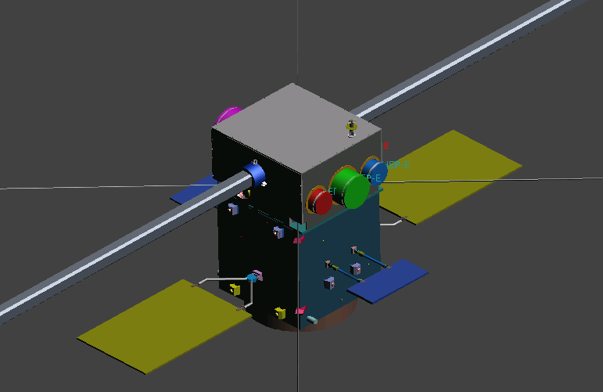
ERG: Field and Waves
PWE: Plasma Wave and Electric Field Experiment (PI: Y. Kasaba, Tohoku. U.)
MGF: Measurement of Geomagnetic Field (PI: A. Matsuoka, ISAS)
1 MHz
PWE
UHR
100 kHz
Whistler
(~kHz)
PWE
(search coil)
10 kHz
1 kHz
magnetosonic
wave
(~100Hz)
1 Hz
Pc1/EMIC
(~Hz)
Pc5/MHD waves
(~mHz)
MGF
(fluxgate)
1mHz
Magnetic
Field
Convective
Field
DC
electric field
magnetic field
ERG/ PWE and MGF measure electric and magnetic field for wide frequency
range from DC to MHz.
- Frequency spectrum and wave-form observations.
Notes:
In the inner magnetosphere, as you know, a lot of kind of plasma and particles coexist.
This figure is schematic picture showing the region and energy range of plasma in the inner magnetosphere.
This axis is L value, indicating from inner magnetosphere to plasma sheet.
On the other hand, this axis is energy from a few eV (thermal energy range) to MeV (relativistic energy).
As the most higher energy range, there are radiation belts, and basically there are two different region of electrons; inner and outer belt.
In the energy around few 10 keV, there exits ring current around L=3 to 6.
The plasma sheet also exists in the night side.
Moreover, in the near earth region, there is plasmasphere.
The origin of the plasmasphere is thermal plasma from ionosphere.
Thus, in the inner magnetosphere, the particles with energy range of order 6 and different origin, solar wind/ionosphere, coexist.
And also, ion population is not only proton but also several heavy ions.

Slide 14
Mission Status & Schedule
FY 2008 - The proposal for Phase-A study was
submitted to ISAS/JAXA.
FY 2009 - Mission Definition Review.
System Requirement Review.
The ERG satellite has been nominated as the second of the small science
satellite series of ISAS/JAXA (SPRINT-B).
SPRINT-A/EXCEED: Planetary Telescope Mission

Slide 15
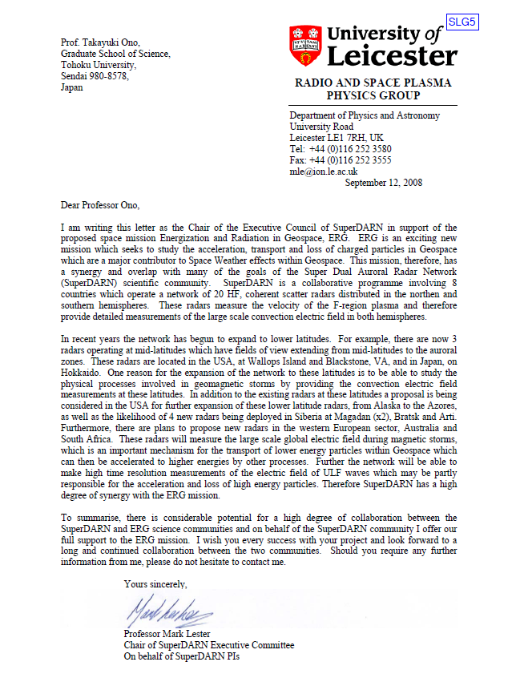
Supporting Letter from SuperDARNs
Thank you very much !

Slide 16
Mission Status & Schedule
FY 2008 - The proposal for Phase-A study was
submitted to ISAS/JAXA.
FY 2009 - Mission Definition Review.
System Requirement Review.
The ERG satellite has been nominated as the second of the small science
satellite series of ISAS/JAXA (SPRINT-B).
FY 2011 - System Definition Review (October, 2011, plan).
Approval by JAXA/HQ.
FY 2012-2013 - Development of Flight Model.
FY 2013-2014 - Integration Test.
FY2014-2015 - Launch.

Slide 17
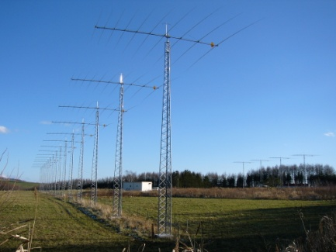
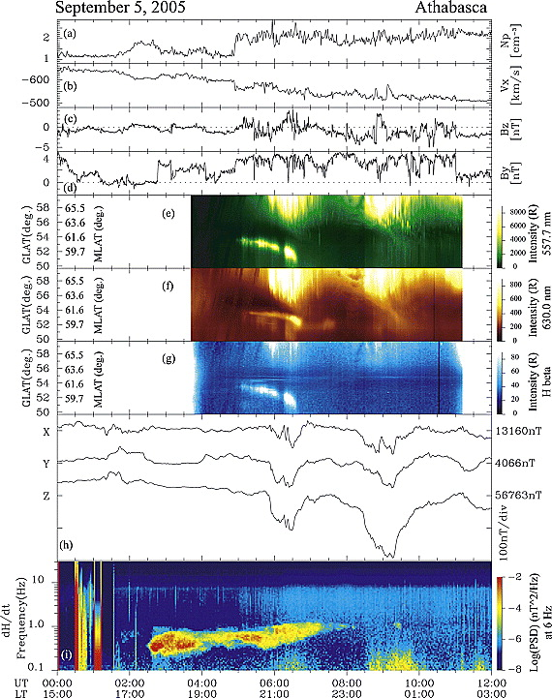
The ERG ground networks (PI: K. Shiokawa, STEL)
・Radar Network: SuperDARN network (HOK, KSR, SWE, SWS), FM-CW radar
global convective electric field
ULF pulsation (Pc5)
Electric field penetration
・Magnetometer Network：MAGDAS/CPMN, Silk-Road, Antarctic Network
- ionospheric current /ring current.
- ULF pulsation (Pc5).
- EMIC (Pc1).
- diagnostics of plasmasphere
ULTIMA supports the ERG-project.
・Optical Imager Network：Canada, Norway, Siberia, Antarctica
Measurement of electron/proton precipitations
Sakaguchi et al. JGR, 2008

Slide 18
The ERG ground networks
・VLF observations: Antarctica/Canada
whistler (chorus, hiss) observations
・Riometer observations：Antarctica/Canada
Imaging of precipitation of tens keV electrons
・LF-wave observations ： Svalbard/Canada
Monitoring of D-layer disturbance
Estimation of MeV electron precipitations

Slide 19

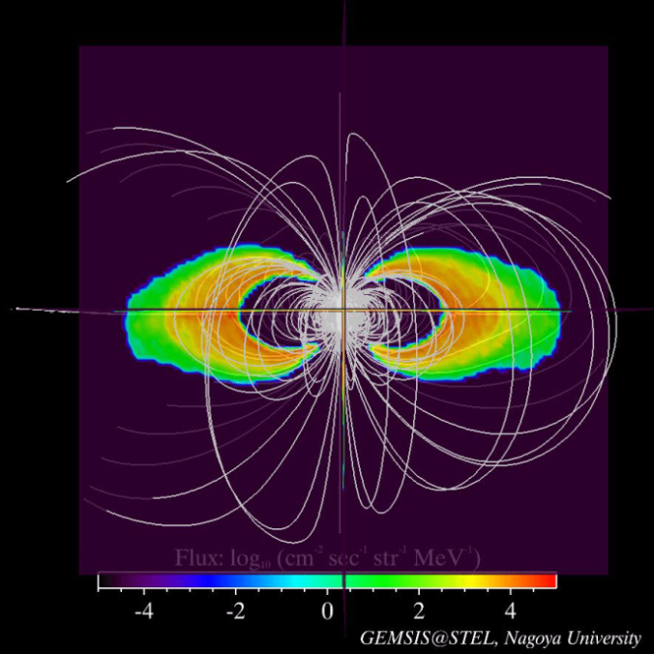
The ERG simulation/integrated studies (PI: K. Seki, STEL)
Integrated data analysis tool and comprehensive simulations which can be
compared with the observations are necessary for the ERG project.
Ring Current Model
Radiation Belt Model
Amano et al., JGR, 2011
Self-consistent simulation with 5-D Boltzmann equation/Maxwell equation.
It is possible to simulate fast/Alfven mode waves
in the inner magnetosphere.
Saito et al. JGR, 2010
-High-precision test particle simulation
code in the realistic 3D magnetic fields
during storm time.

Slide 20
Science Coordination Team (Ld. Y. Miyoshi, STEL)
Planning and coordination of science program of the ERG project.
-Arrangement of the international collaborations.

Slide 21
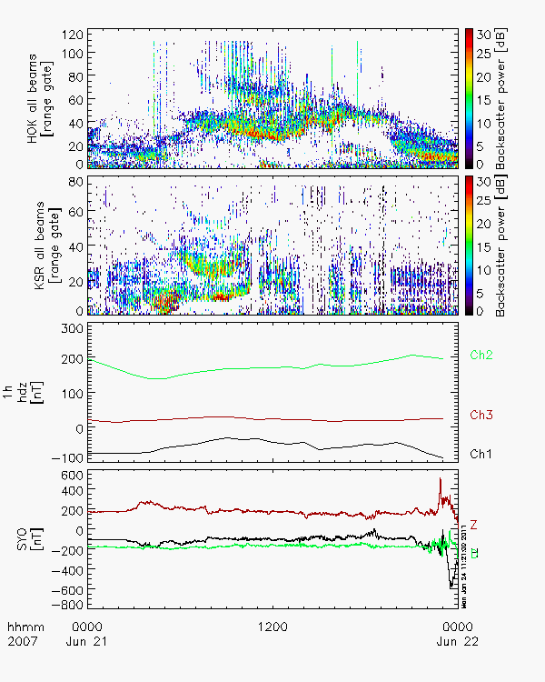
Project Science Center (Ld. K. Seki, STEL)
Integrated data analysis system for many kind data (space, ground, simulation)
is essential for geospace science.
HOK
ERG-data analysis procedures are developed
based on the THEMIS data analysis software.
It is very easy to make combined plots
of many kind data.
- Design/Development of CDF files.
All science data of the project have been
archived in CDF files.
- Development of software.
Plug-in software to read CDF files have
been developed in cooperation with THEMIS.
KSR
210MM mag
Antarctica mag

Slide 22
Development/Release Scheme of CDF and plug-in software
1. Development of CDF and Plug-in softwares
Design of CDF in the consortium of observation groups in Japan.
[ex. Magnetometer consortium, SuperDARN consortium]
PI check (rules of the road)
2. Test Release of CDF and Plug-in Softwares to ERG-WG
Permission by PI
3. Release to Japanese STP community
CDF and plug-in softwares can be used in Japan STP researchers
with IP address control.
Permission by PI
4. Plug-in Software are included in THEMIS software. Release to Public.
The official THEMIS-IDL tool includes plug-in software and is
released from THEMIS website.

Slide 23
Current Status
1. Development of CDF and Plug-in software
- Induction Magnetometer data (STEL, NIPR)
EISCAT, VLF and Riometer at Antarctica.
2. Test Release of CDF and Plug-in Software to ERG-WG
3. Release to Japanese STP community
2011/05 :
- Common time fitacf data of Japanese SD data (HOK, KSR, SYE, and SYS)
4. Plug-in Software are included in THEMIS software. Release to Public.
2011/03 : THEMIS tool Ver6.0 has been released.
- 210 MM magnetometer data
- NIPR magnetometer data at Antarctica, Iceland

Slide 24


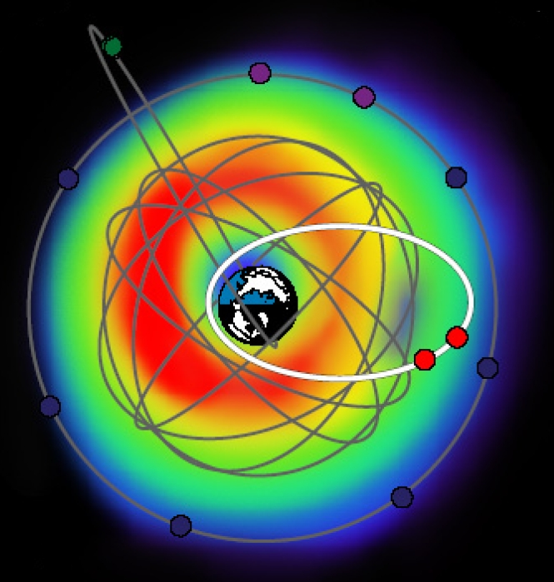
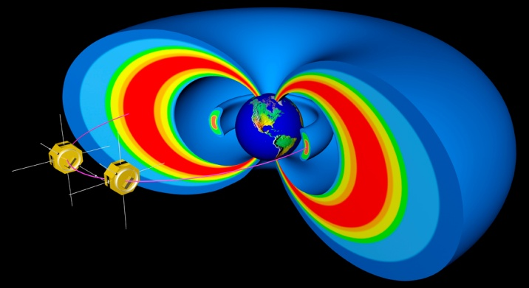
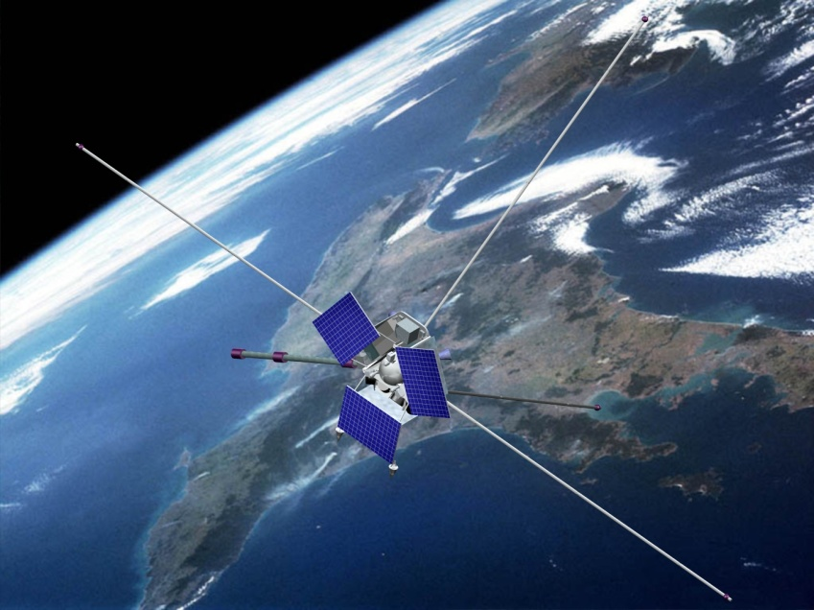
3. International Collaboration: international fleet of satellites
US/THEMIS
US/RBSP
2012
Canada/ORBITALS
Russia/RESONANCE
Japan/ERG
2014-2015

Slide 25
3. International Collaboration: coordinate studies
Sun
Solar Wind
Geospace-
Ionosphere
ORBITALS
RBSP
SuperDARNs
Radiation Belts
Ring Current
LANL
GOES
Auroral Cameras (THEMIS etc)
ERG
Magnetometer
(ULTIMA, 210MM, THEMIS,etc)
Reimei
Geospace-
Magnetosphere
CASSIOPE
FORMOSAT-5
CINEMA
THEMIS
Geotail
Cluster
POES
RESONANCE

Slide 26
4. Collaboration with SuperDARNs
Ground network observations at sub-auroral latitudes :
Coordinated observations between the ground based observations and the ERG satellite.
Global convective electric field / Pc5
Magnetic Bay/Pc5/Pc1 observations
Outer radiation belt
Proton/Electron aurora observations
FOV of HOK

Slide 27
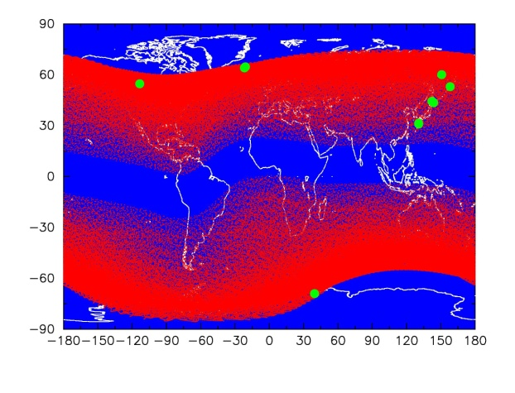
Footprints of the ERG satellite
planned orbit: 2014-2015

Slide 28
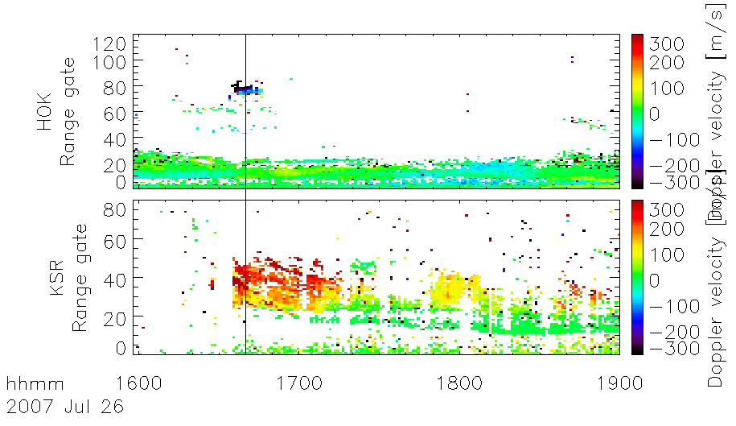
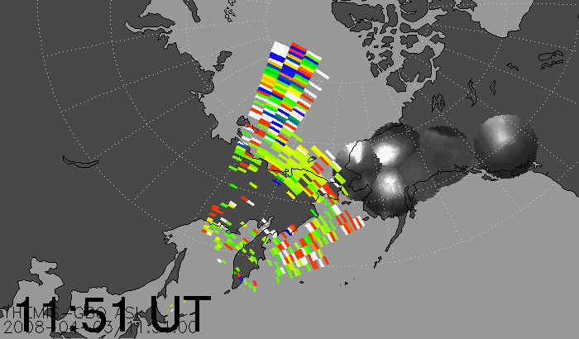
Development of CDF and Data Visualization Procedures
CDF files of common time fitacf data for Japanese SD and plug-in software
are now released to Japanese STP community.
HOK
KSR
KSR
THEMIS/ASI
HOK
Please look at poster presentation by Hori et al. in detail.
HOK
If you are interested in, please use programs to make CDF of CT fitacf data
as well as plug-in software in THEMIS data analysis software.
We hope that CDF files of CT fitacf data for Japanese SD radars
can be available from the world STP community via THEMIS data analysis
software.

Slide 29
5. Summary
The ERG satellite project is now going as the second of small science satellite
series of ISAS/JAXA. The planned launch will be FY2014-2015.
System Definition Review is planned in this fall, and we will start development
of the flight model after the approval by JAXA/HQ.
- The ground network observations/integrated studies/science center
have started their activity.
- International collaboration with RBSP, ORBITALS, RESONANCE,
THEMIS, CINEMA, GOES/POES, LANL, SuperDARNs, and other
ground networks etc. would be very good chance for study of
geospace.
We hope to collaborate on the coordinate observations between
SuperDARNs and ERG project (ground network and satellite observations).

Slide 31
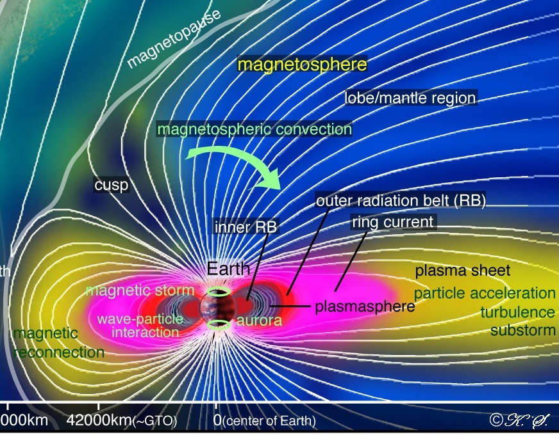
1. Introduction ・・・ Geospace
Van Allen RADIATION BELTS (MeV)
RING CURRENT (keV)
PLASMASPHERE (eV)

Slide 32
Internal Source via wave particle interactions
internal sources (w-p interactions) – violation of all invariants
relativistic
(～ MeV)
inner belt
outer belt
acceleration
whistler
sub-relativistic
wave growth
energy
hot
(～ 100 keV)
ring current
ring current
plasma sheet
thermal
(～eV)
plasmasphere
L=3
L=6
Variations of the plasmasphere are also essential to control the acceleration conditions,
because the plamasphere plays as an ambient media of plasma waves.
Notes:
In the inner magnetosphere, as you know, a lot of kind of plasma and particles coexist.
This figure is schematic picture showing the region and energy range of plasma in the inner magnetosphere.
This axis is L value, indicating from inner magnetosphere to plasma sheet.
On the other hand, this axis is energy from a few eV (thermal energy range) to MeV (relativistic energy).
As the most higher energy range, there are radiation belts, and basically there are two different region of electrons; inner and outer belt.
In the energy around few 10 keV, there exits ring current around L=3 to 6.
The plasma sheet also exists in the night side.
Moreover, in the near earth region, there is plasmasphere.
The origin of the plasmasphere is thermal plasma from ionosphere.
Thus, in the inner magnetosphere, the particles with energy range of order 6 and different origin, solar wind/ionosphere, coexist.
And also, ion population is not only proton but also several heavy ions.

Slide 33
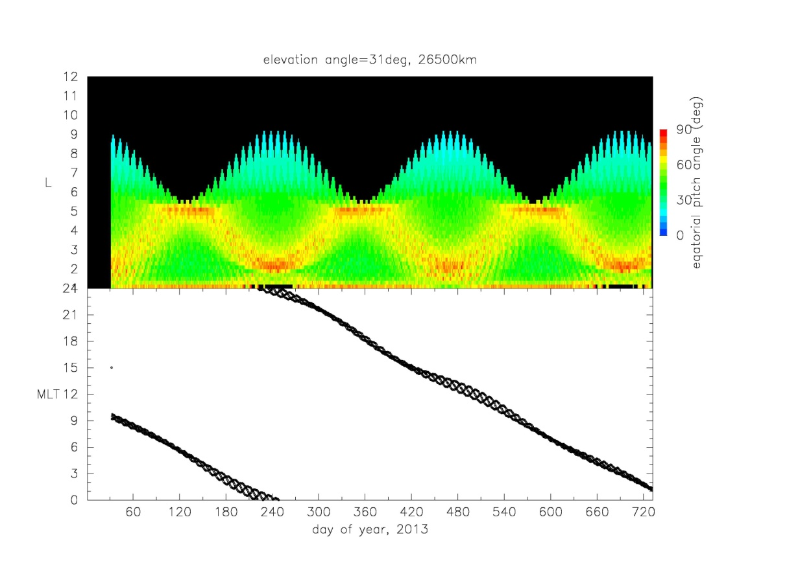
Planned orbit – MLT and Pitch Angle coverage
12
Apogee
(equator at dawn)
Apogee
(equator at dusk)
Apogee
(equator noon-dawn)
Equatrial PA
10
90
8
60
L
6
30
4
0
2
24
18
Launch
dusk
Apogee
MLT
12
noon
6
dawn
0
60
120
180
210
240
270
300
330
360
390
420
day

Slide 34
Appearance of the ERG satellite
Size: 0.95 m X 0.95 m X 1.705 m (w/o projection)
Weight: 350 kg
Spin: Sun-oriented spin (7.5 RPM)
Attitude accuracy: less than 0.5 deg (star sensor)

Slide 35
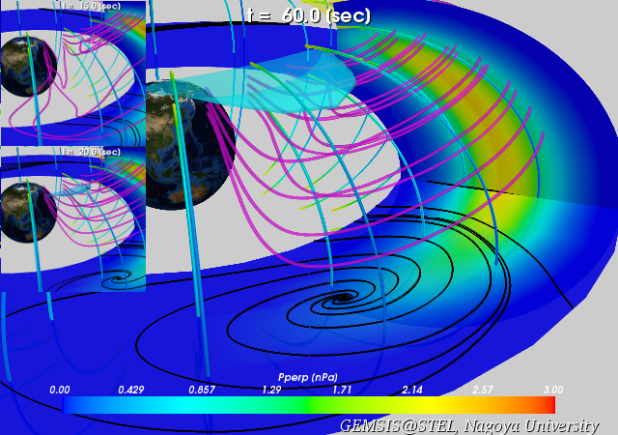
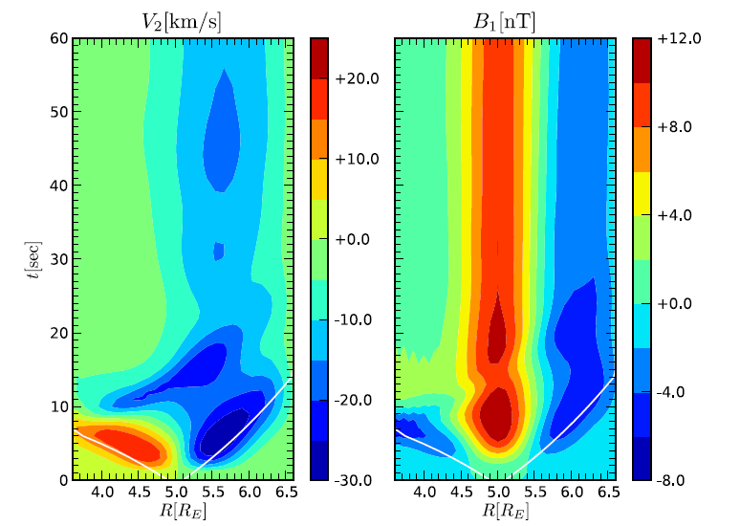
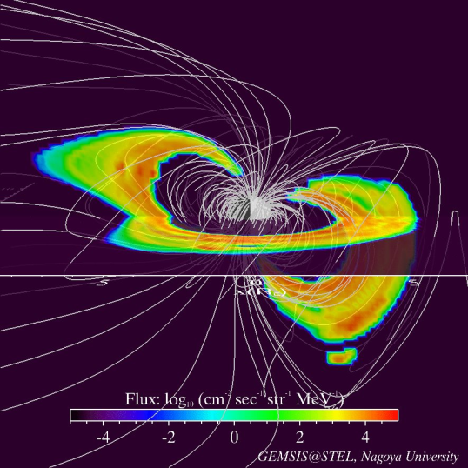
4. Collaboration with RBSP (ERG-pre launch phase)
Comparative study between the simulations and the RBSP observations
Evolution of plasma flow and current (RC and FAC)
Evolution of MHD mode waves
Self-consistent fast mode wave simulation is important to understand the shock accelerations of MeV electrons.
Spatial / pitch angle distribution of energetic particles
Simulation in the realistic magnetic field is important
to understand the dynamics of the trapped particle.
e.g., pitch angle distributions at different positions.

Slide 36
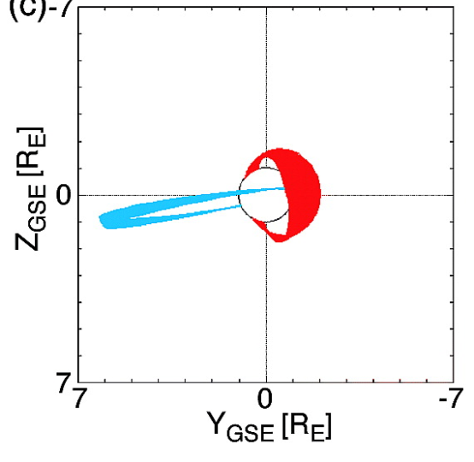
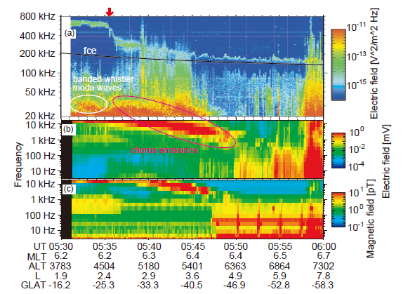
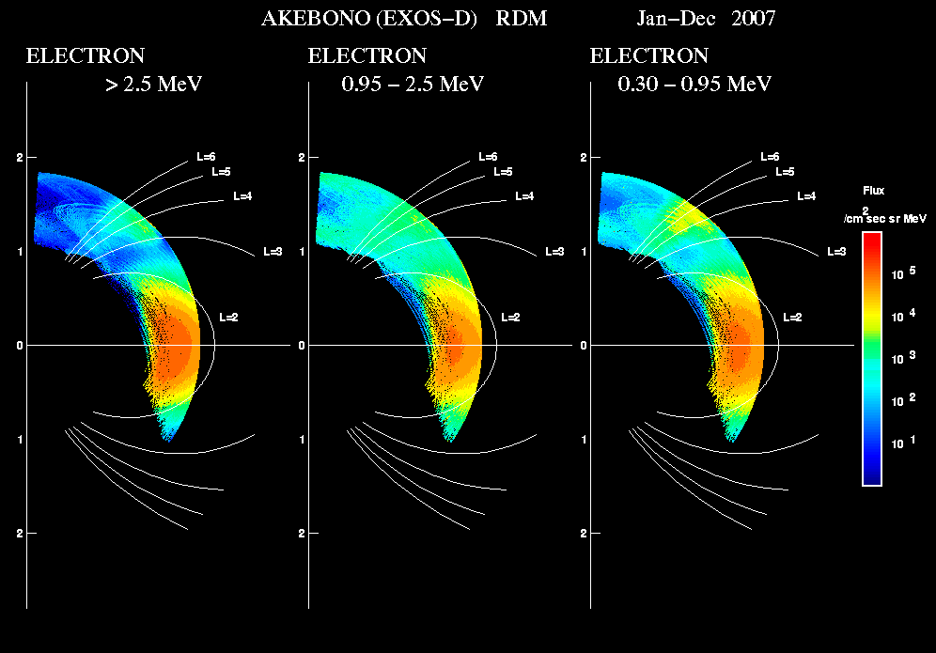
4. Collaboration with RBSP (ERG-pre launch phase)
Coordinated studies with the Akebono satellite
- wave observations (1 Hz – 5000 kHz)
- energetic electrons (300keV, 900 keV, 2500 keV)
Akebono
CRRES--RBSP
Coordinated observations between the equatorial plane and middle-latitudes.
Seki et al., 2005
Plasma wave observations (1Hz -5000 kHz)
Radiation Monitor
>2500 keV
950 keV
300 keV
Tadokoro et al., 2009

Slide 37
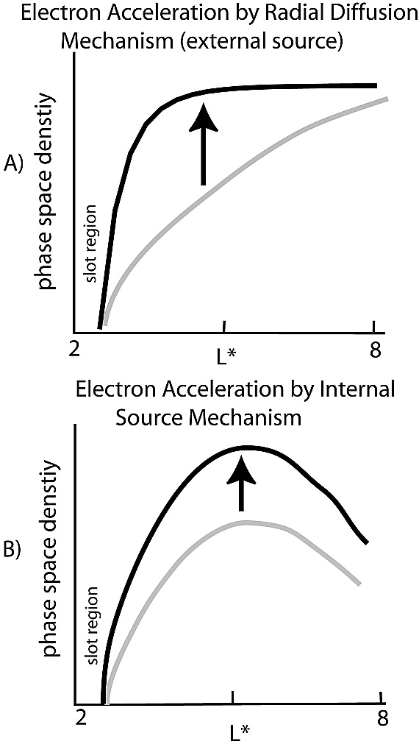
Internal Source via wave particle interactions
internal sources (w-p interactions)
relativistic
(～ MeV)
inner belt
outer belt
acceleration
whistler
sub-relativistic
wave growth
energy
hot
(～ 100 keV)
ring current
ring current
plasma sheet
thermal
(～eV)
plasmasphere
L=3
L=6
Cross-Energy Coupling between particles of widely differing
energies over 6 orders via wave-particle interactions is
important to generate relativistic electrons in the inner
magnetosphere.
PSD profile
Notes:
In the inner magnetosphere, as you know, a lot of kind of plasma and particles coexist.
This figure is schematic picture showing the region and energy range of plasma in the inner magnetosphere.
This axis is L value, indicating from inner magnetosphere to plasma sheet.
On the other hand, this axis is energy from a few eV (thermal energy range) to MeV (relativistic energy).
As the most higher energy range, there are radiation belts, and basically there are two different region of electrons; inner and outer belt.
In the energy around few 10 keV, there exits ring current around L=3 to 6.
The plasma sheet also exists in the night side.
Moreover, in the near earth region, there is plasmasphere.
The origin of the plasmasphere is thermal plasma from ionosphere.
Thus, in the inner magnetosphere, the particles with energy range of order 6 and different origin, solar wind/ionosphere, coexist.
And also, ion population is not only proton but also several heavy ions.

Slide 38
Radial diffusion model for particle transportation
Random resonance is modeled as diffusive process. The Fokker-Planck equation
for the phase space diffusion has been used for the modeling.
radial diffusion model
diffusion / betatron acceleration
PSD profile
Green and Kivelson, 2004
- Electrons diffuse along the phase space density gradient.
Gradual slope of the phase space density should be observed when the flux
enhancement takes place.

Slide 39
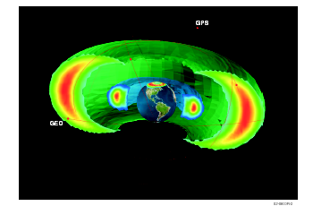
What mechanisms produce the large flux enhancement?
Direct observations near the magnetic equator is necessary.
Necessaries of
- comprehensive observations near the magnetic equator.
- wide energy range particle observations.
- high-quality observations to confirm the phase space density profile and
non-linear processes.
plasmasphere
？
outer belt

Slide 40
Significance of this project.
・ direct observations on generation of relativistic electrons
→ contribution to understanding of the particle acceleration
in the universe.
・ instrumental development to measure plasma and fields
under the incidence of radiation belt particles with small satellite
→ contribution to the future Jovian mission.

Slide 41
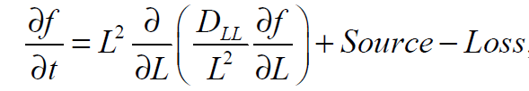
External Source vs. Internal Source – importance of PSD profile
Fokker-Planck equation about the phase space density
has been used for the radial diffusion.
external
internal
Green and Kivelson, 2004
Gradual slope of the phase space density
should be observed in the external source
process.
Peak(s) should appear in the internal source
process.
Accurate measurement of the phase space density profile is necessary.
Notes:
In the inner magnetosphere, as you know, a lot of kind of plasma and particles coexist.
This figure is schematic picture showing the region and energy range of plasma in the inner magnetosphere.
This axis is L value, indicating from inner magnetosphere to plasma sheet.
On the other hand, this axis is energy from a few eV (thermal energy range) to MeV (relativistic energy).
As the most higher energy range, there are radiation belts, and basically there are two different region of electrons; inner and outer belt.
In the energy around few 10 keV, there exits ring current around L=3 to 6.
The plasma sheet also exists in the night side.
Moreover, in the near earth region, there is plasmasphere.
The origin of the plasmasphere is thermal plasma from ionosphere.
Thus, in the inner magnetosphere, the particles with energy range of order 6 and different origin, solar wind/ionosphere, coexist.
And also, ion population is not only proton but also several heavy ions.

Slide 42
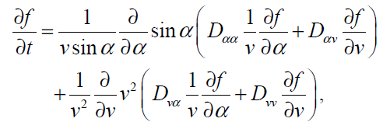
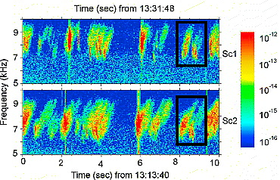
Mechanism of accelerations: importance of non-linear process
Ex. Internal source by wave-particle interactions
Quasi-linear has been considered for generation of waves and acceleration of particles
assuming the uniform fp/fc conditions.
[ Recent studies]
Non-linear trapping process is essential
for chorus wave generation and
causes the elite of relativistic electrons.
Santolik et al. 2003
Katoh and Omura, 2007
Detail observations of non-linear process is necessary.
Notes:
In the inner magnetosphere, as you know, a lot of kind of plasma and particles coexist.
This figure is schematic picture showing the region and energy range of plasma in the inner magnetosphere.
This axis is L value, indicating from inner magnetosphere to plasma sheet.
On the other hand, this axis is energy from a few eV (thermal energy range) to MeV (relativistic energy).
As the most higher energy range, there are radiation belts, and basically there are two different region of electrons; inner and outer belt.
In the energy around few 10 keV, there exits ring current around L=3 to 6.
The plasma sheet also exists in the night side.
Moreover, in the near earth region, there is plasmasphere.
The origin of the plasmasphere is thermal plasma from ionosphere.
Thus, in the inner magnetosphere, the particles with energy range of order 6 and different origin, solar wind/ionosphere, coexist.
And also, ion population is not only proton but also several heavy ions.

Slide 43
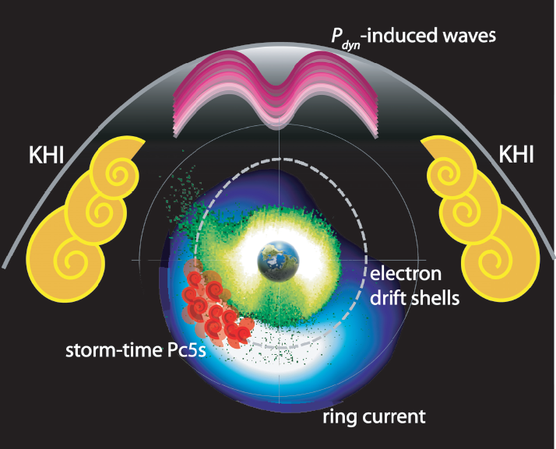
Sources of Pc5 waves in the inner magnetosphere
Ukhorsky et al., AG, 2009
Solar Wind Drivers -- KHI
Solar wind dynamic pressure
Internal Drivers -- Drift –bounce resonance of ring current ions

Slide 44
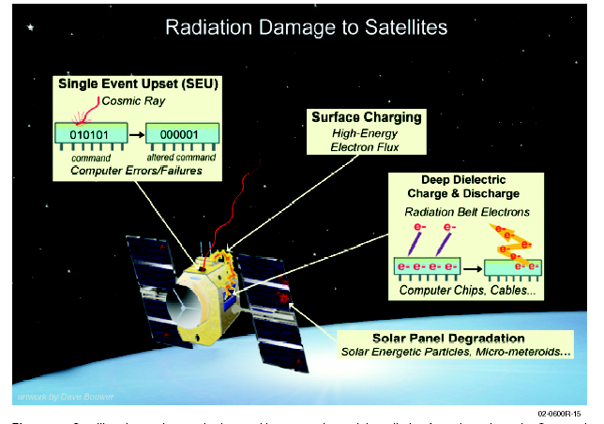
1. Introduction ・・・ killer electrons of the radiation belts
(NASA TM 2002)
MeV electrons of the radiation belts cause satellite anomaly,
so that understanding of the radiation belt dynamics is one of
the key issue of the space weather study.

Slide 45
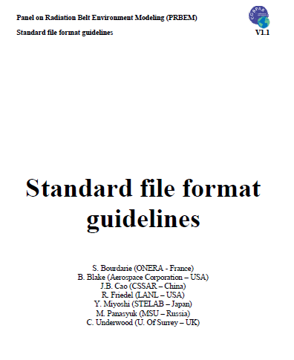
3. International Collaboration: common data format/data analysis tool
- Collaboration about the development of the CDF format
of satellite instrument data (particle, field and waves).
- Definition of the standard CDF format about observational data
as well as meta-data.
- COSPAR/PRBEM will be an effective consortium/framework to
discuss and develop the standard CDF format for energetic particle
and other data for geospace satellite missions.
COSPAR/PRBEM
Standard file format guidlines

Slide 46
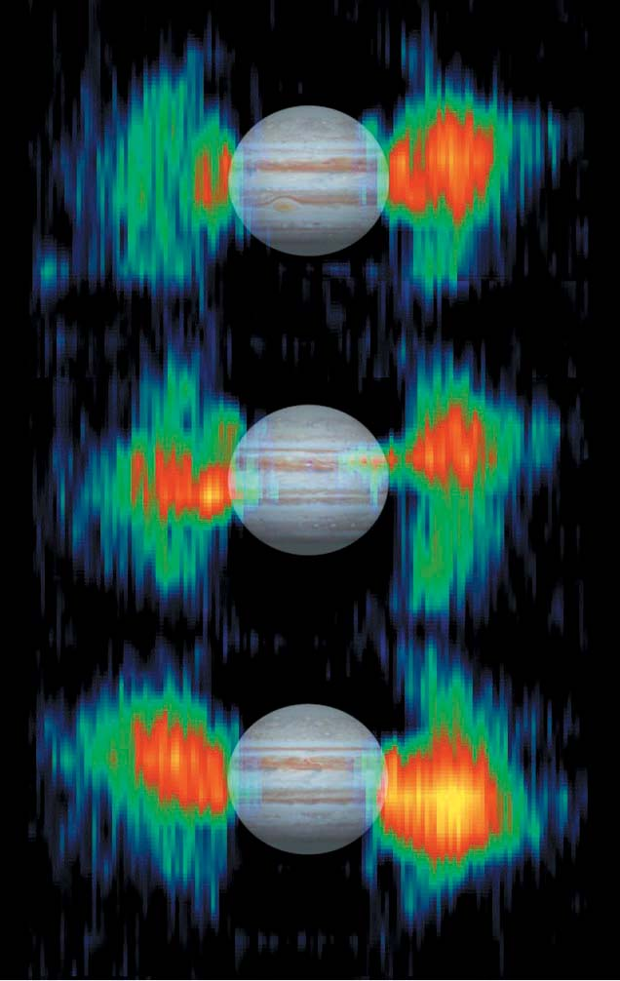
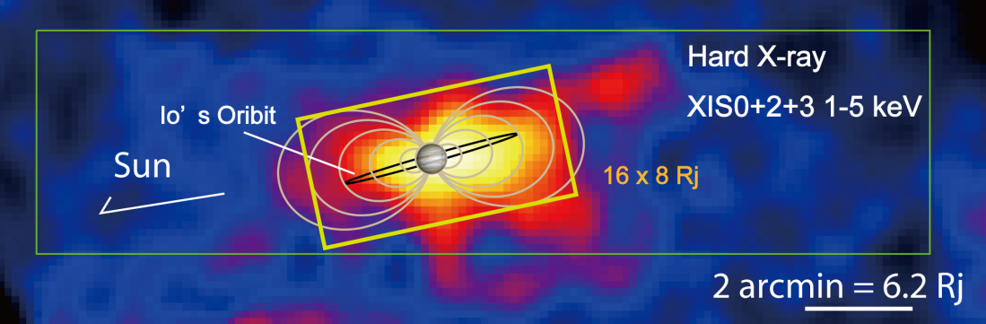
Jovian radiation belt
Ezoe et al., 2010.
Suzaku discovered the hard-X ray
emissions from ultra-relativistic electrons
of Jovian radiation belt by the inverse-Compton scattering.
Bolton et al., 2002
Cassini observed the synchrotron
emission from Jupiter at 11GHz,
and confirmed the existence of
more than 40 MeV electrons

Slide 47
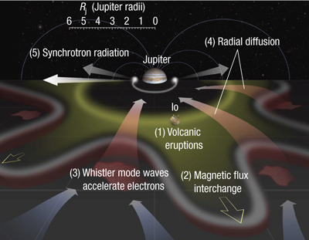
Application to Jovian radiation belt
Horne et al., Nature, 2008
[Non-adiabatic acceleration]
Non-adiabatic acceleration of ultra-relativistic electrons by whistler mode waves in the Jovian
magnetosphere, based on the study of terrestrial radiation belts.
Interchange driven instability with Iogenic plasma works to generate whistler mode waves.

Slide 48
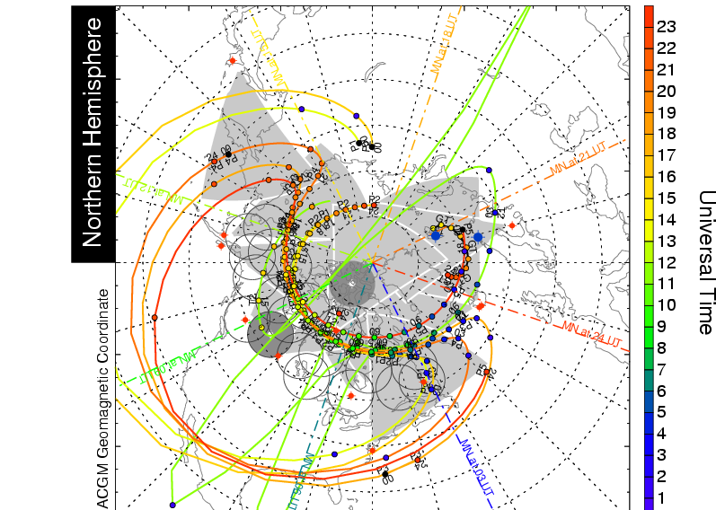

The ERG ground networks (PI: K. Shiokawa, STEL)
Outer radiation belt
Footprint of ERG satellite
FOV of SuperDARN
The footprints of the ERG satellite are within some FOV of ground measurements.

Slide 49
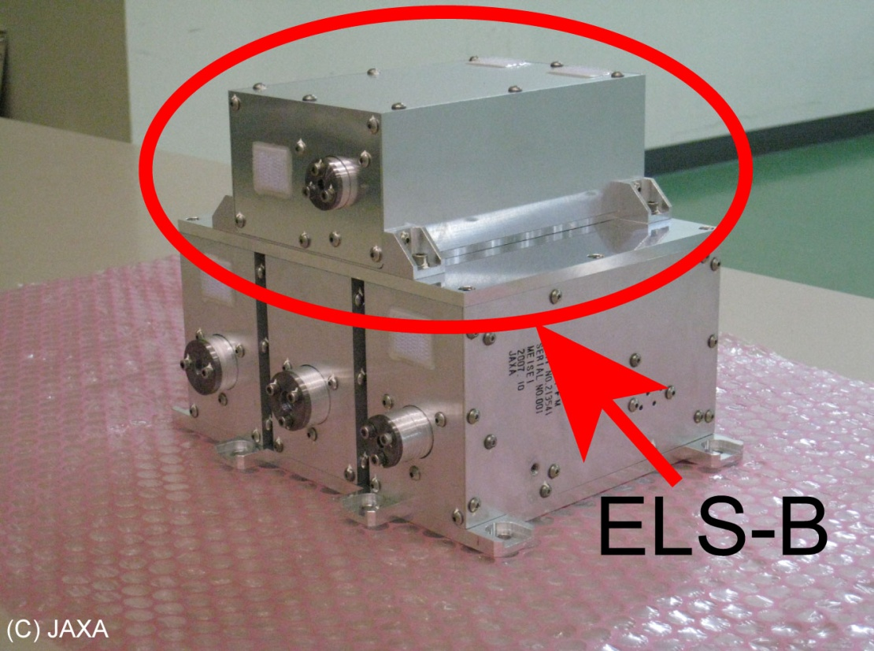
Extremely high-energy electron sensor (XEP-e)
Electron for 0.2 - 20 MeV
Adoption of the ELS-B sensor design and expertise of JAXA in JASON-2 and GOSAT
Radiation shields with 7-mm of aluminum and 3-mm copper

Slide 50
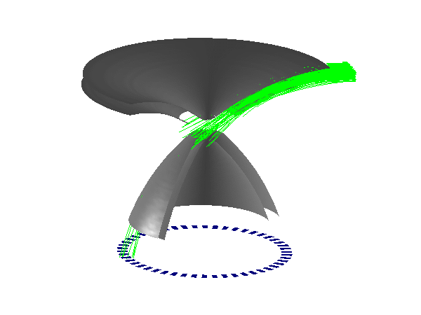
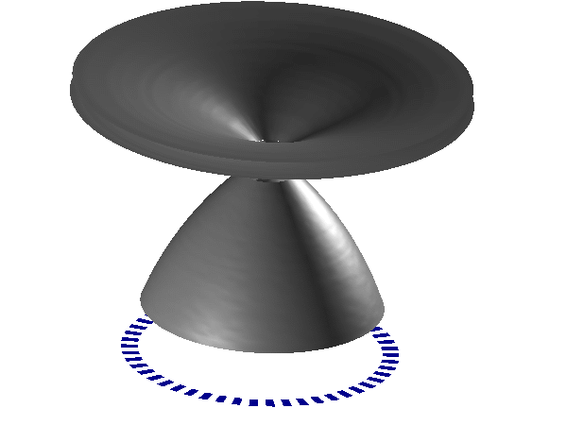
Mid-Energy Particle Instrument for Electron (MEP-e)
Electron for 5 - 80 keV with 360-deg FOV
Cusp-type electrostatic energy analyzer and APD (Avalanche photodiode) array with rough energy analysis
Cusp-type electrostatic analyzer
[c.f. Kasahara et al., 2006]
Array of APDs
[c.f. Ogasawara et al., 2006]

Slide 51

Jovian radiation belt
Ezoe et al., 2010.
Suzaku discovered the hard-X ray emissions from ultra-relativistic electrons of Jovian radiation belt by the inverse-Compton scattering.

Slide 52
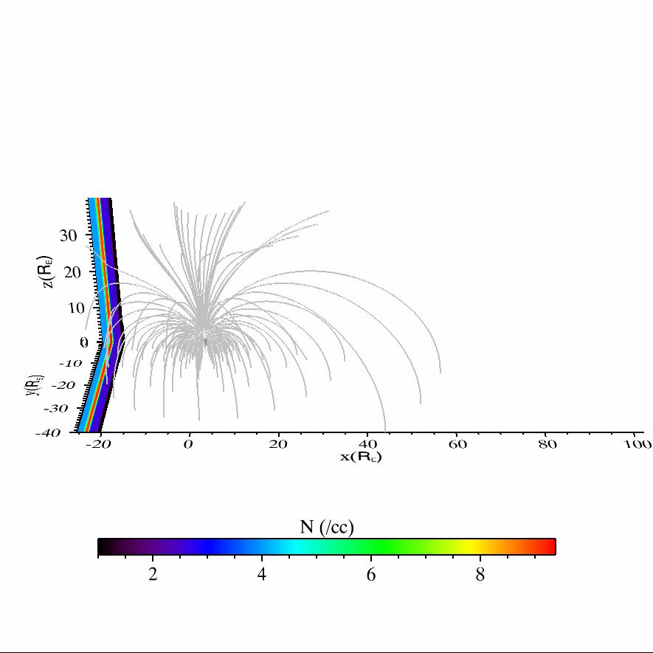
KHI as a source of MHD waves in the inner magnetosphere
Ukhorksy et al., 2009
Y. Matsumoto PEM029-01 (5/25 AM1)
Fast mode is launched at the boundary layer, and propagates into the inner magnetosphere.

Slide 53
1. Introduction ・・・ Geospace
slot region
outer belt
inner belt
MeV electrons of the radiation belts
cause satellite anomaly, so that
understanding of the radiation belt
dynamics is one of the key issue
of space weather study.

Slide 54

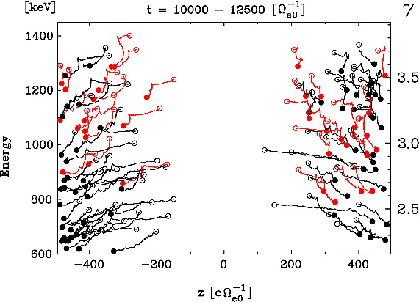
The ERG simulation/integrated studies (PI: K. Seki)
・simulation/integrated studies
Katoh and Omura [2007]
global simulation of the radiation belts
micro simulation for chorus waves
Miyoshi and Jordanova [2009]
Comprehensive simulations including both micro wave-particle interaction
and macro processes, which can be compared with the observations, are
necessary for the ERG project.

Slide 55
2. The ERG project
Significance of this project.
・ direct observations on generation of relativistic electrons
at the magnetic equator in the inner magnetosphere
→ contribution to understanding of the particle acceleration
in the universe.
・ instrumental development to measure plasma and fields
under the incidence of radiation belt particles with small satellite
→ contribution to the future Jovian mission.

Slide 56
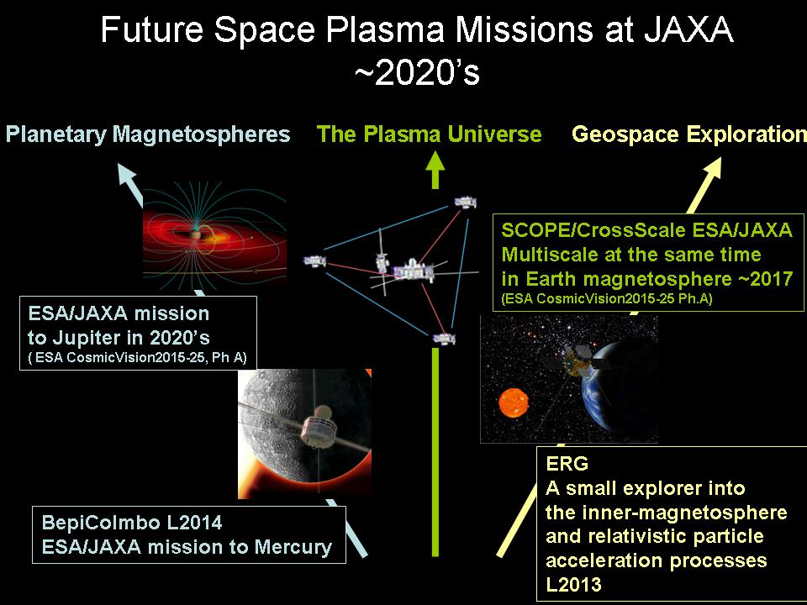

Slide 57
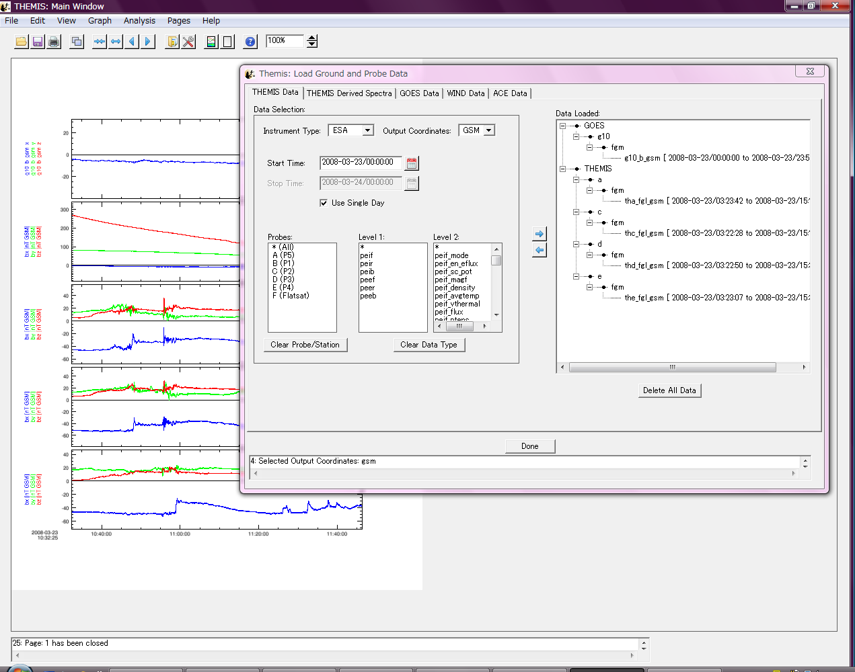
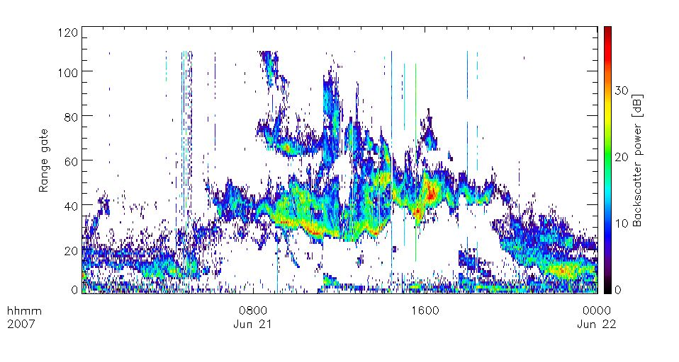
Science Coordination Team/Project Science Center
Design for CDF format of Hokkaido
HF radar (STEL, Nagoya Univ.) to
plot and analysis in TDAS.
IDL> cdf2tplot, file = ‘sd_hok_l2_20070621_v01.cdf’
IDL> tplot, ‘pwr_0’

Slide 58
Mission Status & Schedule
FY 2006 - The official working group of the ERG satellite was approved
in ISAS/JAXA.
FY 2007 - Pre-Phase A study.
FY 2008 - The proposal for Phase-A study was
submitted to ISAS/JAXA.

Slide 59
ERG proposal
September 30, 2008
The proposal has been submitted
to JAXA/ISAS.
Thank you very much for
the supporting letters !

Slide 60
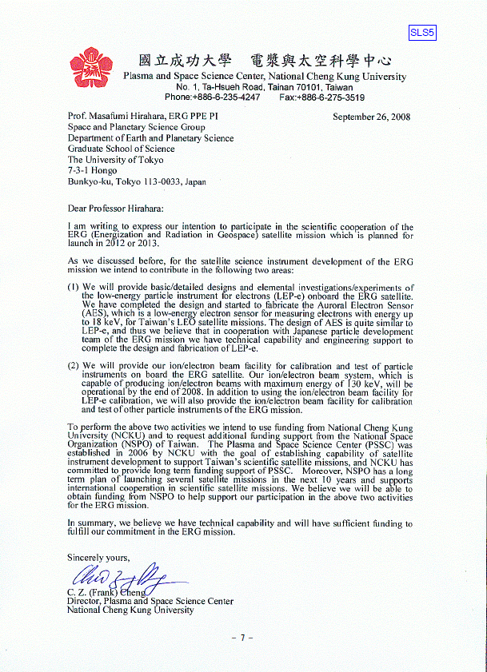
ERG proposal

Slide 61
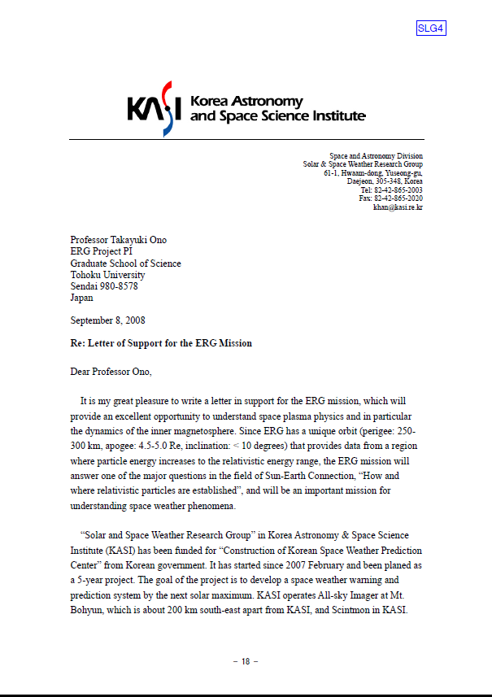
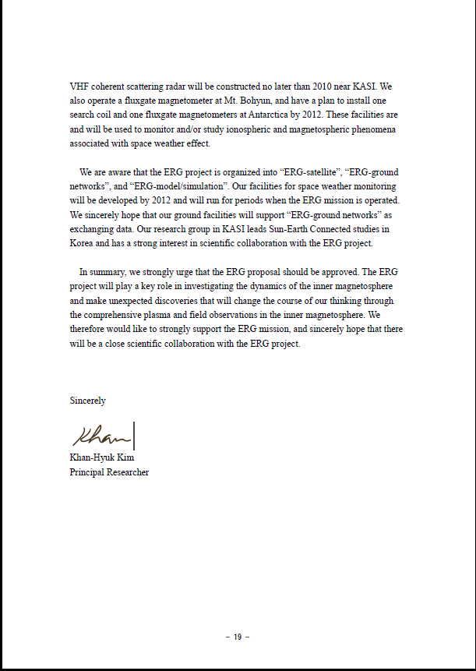
ERG proposal

Slide 62











ERG Project Office
PI: T. Ono (Tohoku Univ.)
Science Management: Y. Miyoshi (STEL, Nagoya Univ.)
Project Science Center: K. Seki (STEL, Nagoya Univ.)
Mission Management: T. Takashima, K. Asamura (ISAS/JAXA)
A. Kumamoto (Tohoku Univ.)
Administrative Office: T. Nagatsuma (NICT)
STP International Coordination: M. Fujimoto (ISAS/JAXA)
ERG Satellite:
PPE PI: M. Hirahara (Univ. Tokyo)
PWE PI: Y. Kasaba (Tohoku Univ.)
MGF PI: A. Matsuoka (ISAS/JAXA)
ERG Ground Networks
PI: K. Shiokawa (STEL, Nagoya Univ.)
ERG Simulation/Integrated Studies
PI: K. Seki (STEL, Nagoya Univ.)
Notes:
62

Slide 63


Slide 64
Development of the Data Analysis Tool

Slide 65
ERG Satellite Science Instruments
Particles
ions
・ ion mass spectrometer (LEPi) ・・・ 10 eV - 25 keV
・ ion mass spectrometer (MEPi) ・・・ 10 keV – 180 keV
electron
・ electron sensor (LEPe) ・・・ 12 eV – 20 keV
・ electron sensor (MEPe) ・・・ 5 keV – 80 keV
・ electron sensor (HEPe) ・・・ 30 keV – 2 MeV
・ electron sensor (XEP) ・・・ 200 keV – 20 MeV
Field & Wave
magnetic field
・ search coil / flux gate magnetometer (DC, ELF, VLF)
electric field
・ electric field and plasma wave instrument (DC – a few MHz)
Notes:
The ERG satellite have science instruments on particles, fields and waves.
In the particle instruments, the satellite measure ions and electron.
As the ion instrumets, there is suprathermal mass spectrumeter and three different ion mass spectrumeter from 40 eV to 1 MeV.
Using these instrumets, we can meaure ion mass spectrum with broad energy range.
As the electron detector, there are three different energy range detector; electrostatic analyzer and SSD.
As the magnetic field instruments, the satellite has flux gate and search coil and can measure the magnetic field from DC to VLF.
Also, the satellite has instruments on electric field and plasma waves, and can measure DC electric field and plasma waves from a few Hz to few MHz.
These plasma wave date would be used for not only plasma wave study but also cold plasma density measurement by measuring UHR and whistler mode waves.
Right now, pre-phase-A study is finished and fulfilled the requirements.

Slide 66

Difference between i=10deg and 31deg
I=31deg is a nominal inclination angle with Japanese rocket.
The observational period for large equatorial pitch angle decreases
to 20-30% compared with the case of i=10deg.

Slide 67
宇宙活動へのインパクト
放射線帯粒子・・・
人工衛星の安全な運用に大きな影響
NASA TM 2002
衛星の帯電・放電、シングルイベントアップセット、太陽電池の劣化
実用的な放射線帯粒子の変動の予測 – 宇宙天気研究

Slide 68

Difference between i=10deg and 31deg
I=31deg is a nominal inclination angle with Japanese rocket.
The observational period for large
equatorial pitch angle decreases
to 25-30% compared with the case
of i=10deg.
It is possible to achieve the science
target with both appropriate launch
schedule and enough observation period.

Slide 69

Expected Occurrence of Space Storm during solar cycle 24
According to solar cycle 22, the occurrence of space storm may decrease
to 40% during the period from 2014 to 2015.

Slide 70
ERG proposal
September 30, 2008
The proposal has been submitted
to JAXA/ISAS.
Thank you very much for
the supporting letters !

Slide 72
Application to Planetary Radiation Belts
Mauk et al., 1989
- There exist radiation belts in the magnetized planets.
- Studies of terrestrial radiation belts will contribute the general understanding of
origin of planetary radiation belts.

Slide 73
Application to Jovian radiation belt
[ External Source Process]
Adiabatic radial diffusion has been plausible mechanism for MeV electrons of Jovian radiation belt.
However, only radial diffusion cannot explain the existence of ultra-relativistic electrons.
Horne et al., 2008
[Importance of chorus wave particle interactions]
Non-adiabatic acceleration of ultra-relativistic electrons by whistler mode waves in the Jovian
magnetosphere, based on the study of terrestrial radiation belts.
Interchange driven instability with Iogenic plasma works to generate whistler mode waves.

Slide 74

ERG project
Notes:
74

Slide 75
2. The ERG project
project goal –
understanding cross-energy couplings for
generation and loss process of relativistic particles
&
variation of geospace during space storms
Significance of this project.
・ direct observations on generation of relativistic electrons
at the magnetic equator in the inner magnetosphere
→ contribution to understanding of the particle acceleration.
・ instrumental development to measure plasma and fields
under the incidence of radiation belt particles with small satellite
→ contribution to the future Jovian mission.

Slide 76
ERG Working Group
PI: T. Ono (Tohoku Univ.)
Science Coordination: Y. Miyoshi (STEL, Nagoya Univ.)
Project Data Center: K. Seki (STEL, Nagoya University)
Mission Management: T. Takashima, K. Asamura (JAXA/ISAS)
Administrative Office: T. Nagatsuma (NICT)
STP International Coordination: M. Fujimoto (JAXA/ISAS)
Satellite:
PPE PI: M. Hirahara (Univ. Tokyo)
PWE PI: Y. Kasaba (Tohoku Univ.)
MGF PI: A. Matsuoka (JAXA/ISAS)
Ground Network
PI: K. Shiokawa (STEL, Nagoya University)
Modeling/Integrated Study
PI: K. Seki (STEL, Nagoya University)
Notes:
76

Slide 77
ERG Working Group
PI: T. Ono (Tohoku Univ.), Science Coordination Contact: Y. Miyoshi (STEL, Nagoya Univ.)
ERG-satellite
Particle Instrument: M. Hirahara (U. Tokyo), T. Yanagimachi (Rikkyo Univ.) T. Takashima, K. Asamura,
Y. Saito, T. Abe, H. Matsumoto, Y. Kazama, S. Kasahara, M. Shimoyama (JAXA), W. Miyake(Tokai Univ.),
K. Ogasawara (SwRI)
Plasma Wave& Electric Field Instrument: Y. Kasaba, T. Ono, A. Kumamoto, Y. Kato (Tohoku Univ.), Y. Kasahara,
S. Yagitani, T. Imachi, Y. Goto (Kanazawa Univ.), H. Kojima, Y. Omura, Y. Ueda (Kyoto Univ.), T. Okada
(Toyama Pref. Univ.), M. Iizima (Daijyo Syukutoku), H. Hayakawa (JAXA), K. Isisaka, S. Miyake
(Toyama Pref. Univ)
Magnetic Field Instrument: A. Matsuoka (JAXA), M. Tanaka, H. Shirasawa (Tokai Univ.),
K. Shiokawa (Nagoya Univ.), Y. Tanaka (NIPR), K. Yumoto, M. Shinohara (Kyushu Univ.), T. Nagatsuma (NICT)
ERG-ground networks
K. Shiokawa, N. Nishitani, T. Kikuchi, Y. Otsuka, R. Fujii (Nagoya Univ.), K. Yumoto, H. Kawano, A. Yoshikawa (Kyushu Univ.), N. Sato, A. Yukimatsu, H. Yamagishi, A. Kadokura, M. Taguchi, Y. Ogawa (NIPR),
K. Hosokawa (U. of Electro-Communications), K. Hashimoto (Kibi International Univ.)
ERG-theory, integrated data center
K. Seki, Y. Miyoshi, A. Ieda, Y. Ebihara, T. Umeda, S. Masuda, Y. Matsumoto, A. Shinbori, T. Hori,
S. Saito, T. Amano (STEL, Nagoya Univ.), K. Murata, H. Shimazu, H. Shinagawa, N. Terada, H. Jin (NICT),
M. Nakamura (Osaka Pref. Univ.), R. Kataoka (RIKEN), M. Nose, T. Iyemori, Y. Omura, S. Machida
(Kyoto Univ.), T, Obara, M. Fujimoto, I. Shinohara, K. Maezawa, Y. Miyashita (JAXA), T. Tanaka
(Kyushu Univ.), S. Watanabe, K. Komatsu (Hokkaido Univ.), T. Higuchi, G. Ueno, S. Nakano (ISM),
M. Hoshino (U. of Tokyo), T. Nagai, K. Asai, T. Terasawa (TITEC), S. Arvelius (IRF), M. Yamada(MPI)
Notes:
77

Slide 78
Science Instruments of the ERG satellite
Plasma/Particles
10 eV
100 eV
1 keV
10 keV
100 keV
1000 keV
plasmasphere
plasma sheet, ring current
radiation belts
electrons
ions
HEP-i
TSP-i
LEP-i
MEP-i
Field & Waves
DC
1mHz
1Hz
100 Hz
1 kHz
10 kHz
100 kHz
ULF
EMIC
magnetosonic
Z-mode/UHR
hiss/chorus
electric field & waves
ERG/PWE
magnetic field
ERG/MGF
ERG/PWE
10

Slide 79
Origin of energetic electron in Geospace – Two different concept
What is the origin of relativistic electrons in Geospace?
＊new idea
relativistic
(～ MeV)
inner belt
outer belt
plasma wave
energy
hot
(～ keV)
ring current
plasma sheet
thermal
(～eV)
plasmasphere
L=3
L=6
The particle which has large magnetic moment at
plasma sheet moves inwardly with betatron acceleration.
Notes:
As the origin of energetic electrons in Geospace, now, two different ideas are proposed.
Simply speaking, one is adiabatic accelearation, and another is non-adiabatic accelaration process.
Again, this is diagram of particle distribution in the inner magnetosphere.
The adiabatic accelraetion process is classical idea which has been considered since 1960’s.
The particle with large magnetic moment in the plasma sheet moves inwardly with radial diffusion.
And the particle can be accelreated to relativistic energy because radial diffusion is adiabatic transport process.

Slide 80
＊new idea
The particles of all energy range, plasma waves and field can contribute particle
acceleration via wave-particle interactions
plasmasphere
plasma wave
10eV
ring current
ring current
outer belt
10keV
100keV
1MeV
Notes:
In order to investigate this non-adiabatic process, the observations of paritcles below 100 keV is necessary.
Also, we guess that the acceleration process should take place at magnetic equatorial plane. The observation at equatorr is quite imporantant.
However, so far, such observations has never performed at magnetic equatoar, because the observaiton under strong radiation hazard is quite difficult.

Slide 81
Origin of energetic electron in Geospace – Two different concept
What is the origin of relativistic electrons in Geospace?
＊classical idea
relativistic
(～ MeV)
inner belt
outer belt
betatron heating
large M
energy
hot
(～ keV)
ring current
plasma sheet
small M
thermal
(～eV)
plasmasphere
L=3
L=6
The particle which has large magnetic moment at
plasma sheet moves inwardly with betatron acceleration.
Notes:
As the origin of energetic electrons in Geospace, now, two different ideas are proposed.
Simply speaking, one is adiabatic accelearation, and another is non-adiabatic accelaration process.
Again, this is diagram of particle distribution in the inner magnetosphere.
The adiabatic accelraetion process is classical idea which has been considered since 1960’s.
The particle with large magnetic moment in the plasma sheet moves inwardly with radial diffusion.
And the particle can be accelreated to relativistic energy because radial diffusion is adiabatic transport process.

Slide 82
The particles of all energy range, plasma waves and field can contribute particle
acceleration via wave-particle interactions
plasmasphere
plasma wave
10eV
ring current
ring current
outer belt
10keV
100keV
1MeV
～ The observation of particles below 100 keV
which are seed and driver for particle acceleration
&
the observation of plasma waves
are necessary at magnetic equator ~
Notes:
In order to investigate this non-adiabatic process, the observations of paritcles below 100 keV is necessary.
Also, we guess that the acceleration process should take place at magnetic equatorial plane. The observation at equatorr is quite imporantant.
However, so far, such observations has never performed at magnetic equatoar, because the observaiton under strong radiation hazard is quite difficult.

Slide 83



The ERG ground networks – remote sensing of geospace
・SuperDARN radar networks
- global convection electric field
ULF pulsation
Hokkaido ‘storm’ radar (Nagoya Univ.)
KingSalmon radar (NICT)
Antarctica SENSE radars (NIPR)
・CPMN, Antarctica Magnetometer networks
- global magnetic field
(large scale bay, ULF pulsation..)
ionospheric current distribution
evaluation of thermal plasma density
・Optical imager networks
Imaging of precipitating particles derived from aurora and SAR arc observations.
New induction magnetometers and
all sky imagers at east Russia will be
installed in this summer.

